Slide 1
Fragile Online Relationship: A First Look at Unfollow Dynamics in Twitter
Haewoon Kwak Hyunwoo Chun Sue Moon
Department of Computer Science, KAIST
The 29th international conference on Human Factors in Computing Systems (CHI)
10th May 2011

Slide 2
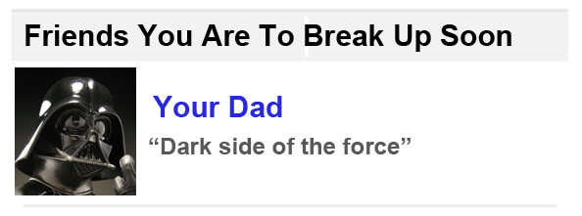
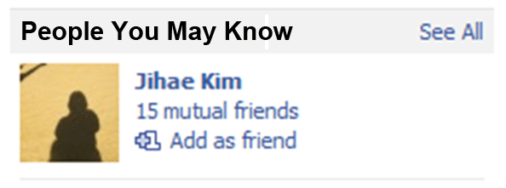
Building and breaking up a relationship
Two basic processes in social network evolution
But we don’t talk about breakup
??
Notes:
Building and breaking up a relationship are two basic processes in social network evolution.
They explain growth and shrinkage of social networks.
But people talk about relationship buildling only.
On Facebook, we often take the recommendations from “People you may know” section.
[CLICK] But we haven’t seen a feature like “Friend you are to break up soon”
Not only in OSNs but also in other domains
we talk about relationship establishment but not about breakup.
Why?

Slide 3
Lack of relationship breakup data
Many records of relationship establishment
Sending and accepting a friend request
Writing a paper together for the first time
Making a call for the first time
Breaking up a relationship
Hard to define and capture
Notes:
Because it’s hard to get data about breakups.
It’s easy to define and capture relationship establishments.
In OSNs, or by paper co-authorships or in phone call logs
In contrast it is very hard to define and capture a breakup.
What is the sign of breakup in a phone call log?
In OSNs people can cancel the friend request and break existing online friend relationships.
But they mostly don’t. The online relationships remain mostly rigid without actual interaction due to cyber etiquette.

Slide 4
A proxy for relationship breakup
Disappearance of e-mail exchange
“Alice & Bob had exchanged e-mails frequently.
At some point they didn’t do any more.”
But they were doing instant messaging.
A proxy is not always accurate!
Notes:
Therefore, researchers have been using proxies for relationship breakups
One widely used proxy is the disappearance of interaction.
Let’s take the email as an example.
Alice and bob had frequently exchanged e-mails. At some points they stopped.
Then, is that relationship broken? The answer is yes or no.
[CLICK] In this case, actually they were doing instant messaging.
So, a proxy is not always accurate.
The problem is: the disappearance of interaction in a single comm channel does not guarantee the intentional action of breaking a relationship.

Slide 5
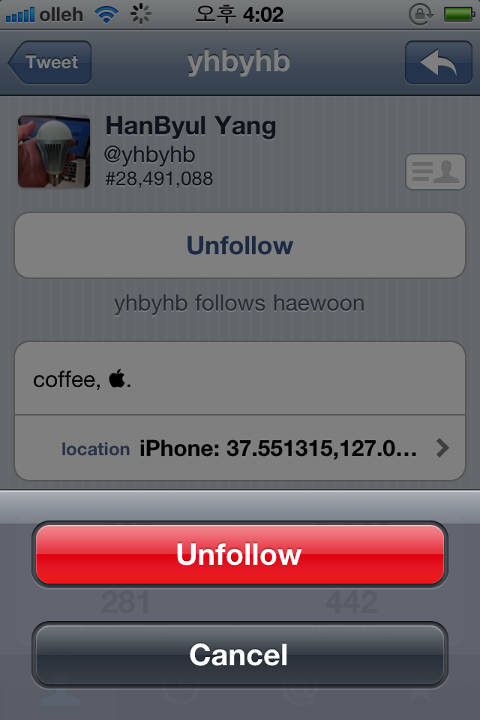
Unfollow in Twitter
Intentional action to break a relationship
No need for an approval
No notification to the unfollowed
Notes:
In this work we focus on unfollow in Twitter.
Unfollow is an intentional action to break a one-way relationship.
It doesn’t require an approval.
And Twitter does not notify the unfollowed who just unfollowed him or her.
People don’t have to worry about cyber etiquette.

Slide 6
Research questions
RQ1: What are the characteristics of unfollow?
RQ2: Why do people unfollow?
Notes:
We raise two research questions.
One is what characters unfollow has.
Unfollow has been not fully studied, so we’d like to charactierize the unfollow behavior.
The second question is about motivaiton. Why people unfollow others.
Through interviews we find answers for this question.

Slide 7
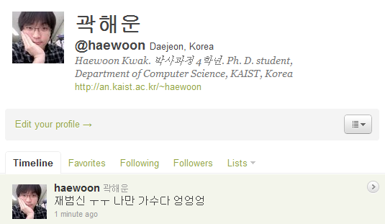
Identify a group with common culture
Not feasible to crawl the entire Twittersphere
Collecting 1.2M Korean-speaking users identified by Korean in tweets, bio, location, or name
Notes:
The first challenge in data collection is how to sample.
In the last year our previous work collect the near-complete Twitter networks but
Twitter now has more than 250M users and we cannot get data about the entire Twitter with our limited resources.
Because cultural belief about relationship can affect the unfollow behavior, we had to pick a set of users in the same cultural context.
We chose to collection data about Korean Twitter users for our familiarity with the language and culture.
We detect 1.2M Korean users if they use Korean in tweets, bios, locations or names.
%If we take a random set of users, then the motivations behind unfollow cannot be interpreted within the same cultural context.

Slide 8
Obtaining unfollow records
Collect daily snapshots of follow networks
G(I): June 25th to July 15th, 2010
G(II): August 2nd to August 31st, 2010
Compare two consecutive follow networks and detect removed relationships
Removed relationship
…
June 25th
June 26th
Notes:
The second challenge is to obtain the unfollow records.
Except the period experiencing server problems we collect daily snapshots of 1.2M users follow network during 51 days.
And we compare two temporaility consecutive daily snapshots of follow networks and detect removed relationships.
So, the time resolution for recording unfollow is a single day.

Slide 9
Korean follow network grew fast
Increasing # of users
G(I): 718,077 → 870,057 +7,599/day
G(II): 956,261 → 1,203,196 +8,515/day
Increasing (high) reciprocity
G(I): 56 → 58%
G(II): 61 → 62%
Increasing avg. # of followees
59.7 → 75.7
Notes:
This Korean follow network is consistently growing.
From the perspective of # of users, reciprocity, and avg # of followees we observe the consistently increasing trends.
So, we observe the phenomena of breaking a relationship in growing network not shrinking network.
- 6분 30초 -

Slide 10
Research questions
RQ1: What are the characteristics of unfollow?
RQ2: Why do people unfollow?
Notes:
Then, we answer the first research question.

Slide 11
People unfollow frequently
43% of active users unfollow at least once during 51 days
Average number of unfollows per person
15.4 in G(I)
16.1 in G(II)
Notes:
We begin with the network-wide statistics of unfollow.
During 51 days 43% of active users unfollow at least once.
The active users are those who have followed or unfollowed once during this period.
And on average, people unfollow others about 15 times in each period.
We confirm that people frequently unfollow others.
So, the growth of Twitter networks are not only explained by relationship formation but also relationship breakup together.
-- 7분 30초

Slide 12
Factors that correlate w/ unfollow
Reciprocity of relationships
Duration of a relationship
Followee’s informativeness
Overlap of relationships
Notes:
We find interesting characteristics such as burstiness, communication partners, correlation with the number of followees and unfollowees,
But due to time constraints, we introduce 4 factors correlating with the unfollow behavior in this talk.
4 factors are … Whether a relationship is reciprocal, how long a relationship remains, how informative a followee is and how relationships are overlapped.
These four factors are not highly correlated w/ each other, so each factor’s influence is not explained by other factors.
In the next few slides I will explain these factors one by one.

Slide 13

One-way relationships are fragile
One-way
P(broken) = 0.1228
<
<
“Emotional closeness”
Reciprocal
P(broken) = 0.0529
P(remaining will be broken|one is broken)
= 0.2345
Notes:
First is whether a relationship is reciprocal.
Reciprocal follow relationships can bring emotional closeness to both users like friends in other online social networks and thus reduce the likelihood of unfollow.
[click] We observe that the one-way relationship is twice more likely to be broken than the reciprocated relationship.
This is agreed with our intuition.
and, interestingly, [click] after one of mutual relationship is broken,
The broken ratio of remaining relationship becomes much higher.
This increasing ratio is observed during our data collection period, so if we enlarge the data collection period, the probability can become much higher.
This is an evidence to show that the reciprocity of relationships has great impact to the unfollow behavior.

Slide 14
Newer relationships are more fragile
Is a user less likely to unfollow those whom the user has been following for some time?
Notes:
Then, duration of a relationship.
If a user follow others for a long time, the user is less likely unfollow them?
To answer this question we have to know when the relationship is created.
But, Twitter does not offer the exact date when one follow others,
Instead, they provide the temporal order of follow relationships in one’s personal network.
We use 20 bins and put each user’s relationships according to the temporal order in personal network and calculate the unfollow ratio in each bin.
we find a clear positive trends.
It means that the longer the followee remains, the less likely that followee is unfollowed.
People find new followees and actively unfollow them. Relationships stabilize over time.

Slide 15
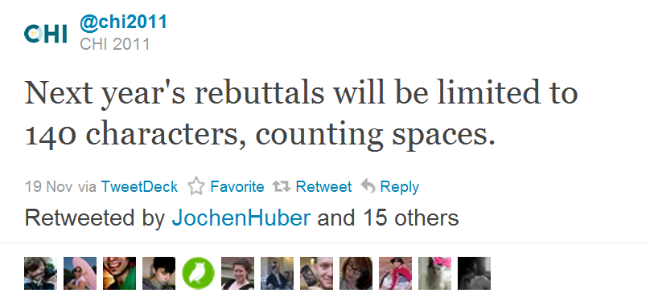
Informativeness of users
Notes:
Next is inFORmativeness of users.
People can unfollow others when no longer interested in reading their tweets.
In other words, the informativeness of user’s tweets can be the
opportunity cost of unfollowing the user. The most common way to assess the informativeness of user’s tweets is how many times are retweeted or favorited.
Here we deﬁne informativeness strictly between a user
and a followee; the informativeness of my followee to me is
measured by only my retweets and favorites.
So, a user’s informativess are differently defined to each follower.
Then we look into the unfollow ratio of relationships involving different number of retweets and favorites

Slide 16
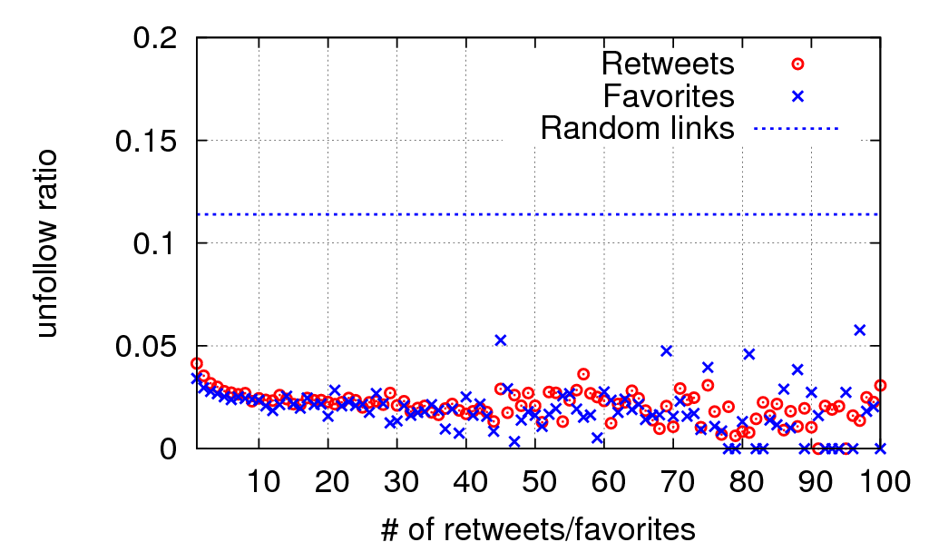
Non-informative relationships are fragile
Notes:
Compared to the broken ratio of an arbitrary link,
we observe low broken ratio of relationships involving a single favorite or a retweet.
If a user retweets or favorites other’s tweet at least once, the user are less likely to unfollow them.
This supports the informativeness of user’s tweets is a reason to sustain the follow relationship.
and retweets and favorites are good indicator of user’s informativeness.

Slide 17
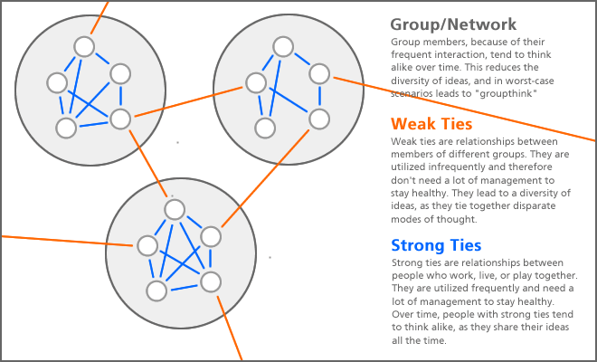
Strong ties & weak ties
http://bokardo.com/archives/weak-ties-and-diversity-in-social-networks/
Notes:
The last factor is overlap of relationships. This is highly correlated with the concept of strong and weak ties.
There are various ways for describing tie strength, but intuitively, the strong ties are relationships between people who work, play, or live together.
So, their relationships are commonly overlapped. But, weak ties are relationships bridging people of the different user community.
So, their relationships are not overlapped well.
The tie strength can be measured by the overlap of relationships, and a few work have successfully demonstrated it with real data.

Slide 18
Weak ties are fragile
Notes:
So, we find the correlation between the overlap of neighbors and unfollow ratio of those links.
Up to 0.26 slightly increasing trend, and beyond that the clear negative trend are observed in this figure.
The left part we think there are coming from the mix of hub users and common users.
But the right side of this graph shows the clear sign that strong ties are less likely to be broken.

Slide 19
No interaction ≠ breakup
85.6% of relationships do not involve any single reply, mention, or retweet
96.3% involve 3 or fewer
People just subscribe to others’ tweets passively
Notes:
One of important findings is no interaction cannot be a proxy for unfollow because of users’ passivity.
85.6% of links do not involve any single reply, mention, or retweet and 96.3% involve 3 or fewer tweets only.
So, people just subscribe followees’ tweets passsively through the one-way relationship.
This finding clearly shows why the explicit notion of relationship breakup, here unfollow, is important for the quantitative study.

Slide 20
Research questions
RQ1: What are the characteristics of unfollow?
RQ2: Why do people unfollow?
Notes:
Then we answer the second question. About user’s motivation behind unfollow.

Slide 21
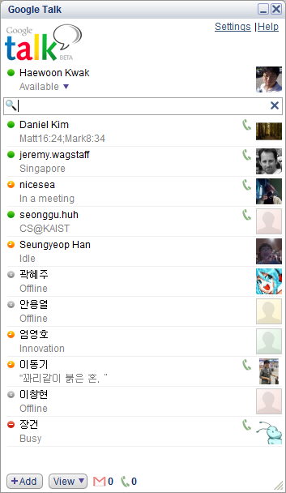

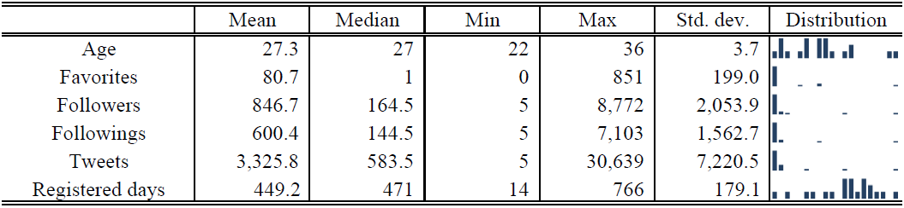
22 online & face-to-face interviews
Recruited by word-of-mouth
Semi-structured
Logging & camera recording
11 Male, 11 Female
Notes:
For user interviews we recruited 22 participants by word-of-mouth.
11 males and females and various range of # of followers, followees, and periods of using twitter.
The interview is semi-structured, so the question is fixed and participants freely answer and we throw the follow up question.
The interview is conducted either by online messengers or face-to-face communication.

Slide 22
Top reasons in unfollow
Burst tweets
Tweets about uninteresting topics
Tweets about mundane details of daily life
Automatically generated tweets (4sq)
Tweets about political issues
Notes:
And we ask questions about the experience of unfollow and unfriend in Facebook, the purpose of using Twitter, … and some other things.
But we cover top reasons in unfollow here.
People don’t like burst tweets, tweets about uninteresting topics, about mundane details of daily life and about political issues.
Even celebrities or close friends, people unfollow them when they created burst tweets.
and, people are annoyed by the automatically generated tweets, such as foursquare, along the weak tie.
Some of them are interested in location information of close friends but not weak ties.

Slide 23
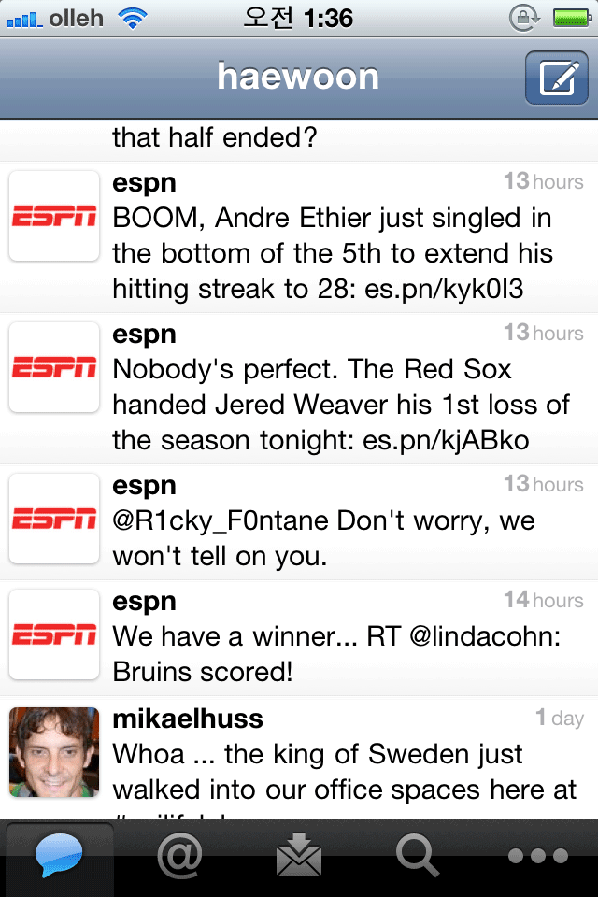
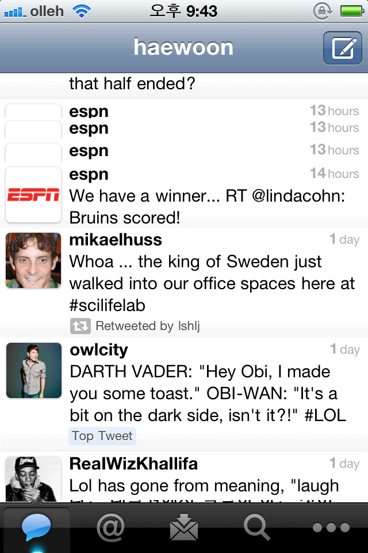
Application: Practical uses
Burst tweets, automatically generated tweets, …
Notes:
This interviews suggest UI improvements to filter and list tweets.
With a n interface such as the folding feature,
We can relieve the burden of burst tweets, automatically generated tweets, or political tweets,

Slide 24
Application: Theoretical models
Existing models for growing networks deal with new relationship formation only
Preferential attachment model
Forest fire network model
We add another dimension to network evolution models from the perspective of relationship breakup
Notes:
And our work can apply to the theoretical models for network evolution.

Slide 25
Discussion
Generalization of this work
One user group study
Online relationship not equal to social friendship
Notes:
Prior to summary, we’d like to clearly mention what we have done and what we have not.
In this work we look into a single population only. so we need corroborating evidence to support our findings for generalization.
The other point is about the nature of online relationship.
The follow relationship is not equal to social friendship, and also is different from friends in other OSN.
In our previous work we show Twitter is more like information sharing network rather than social network.
So, for applying our findings to other OSNs we need more data from there.

Slide 26
Summary
Unfollow is a clear sign of breaking a relationship
None of interaction is not a good indicator of breaking a relationship due to user’s passivity in Twitter
The first study of the unfollow behavior
Quantitative data analysis revealed its characteristics
Qualitative interviews found its motivation
Notes:
In summary, unfollow is a clear sign of breaking a relationship.
none of interaction is not a good indicator of breaking a relationship due to user’s passivity in Twitter.
And This is the first study of the unfollow behavior.
through quantitative and qualitative analysis we revel four factors correlating with unfollow, reciprocity, duration, informativeness, and relationship overlap, and motivation behind unfollow.

Slide 27
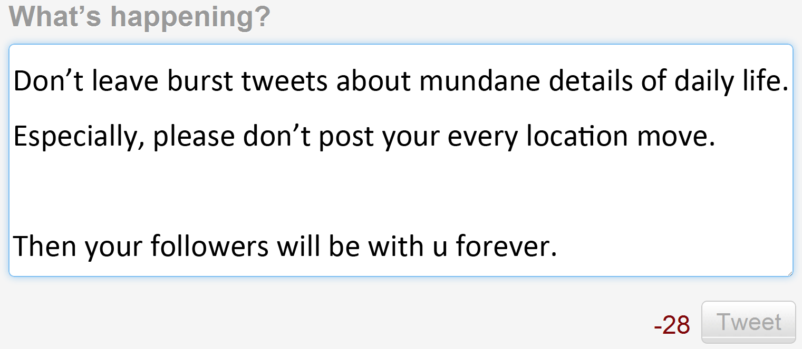

Slide 28
Backup slides

Slide 29
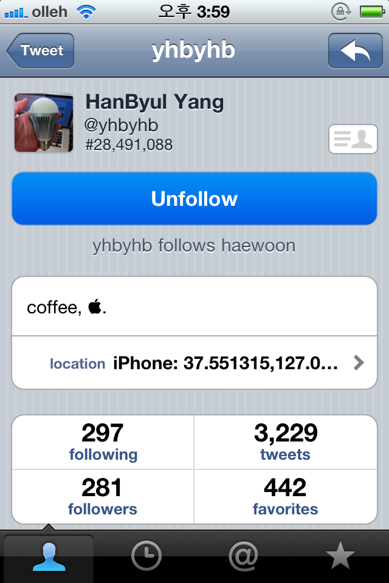
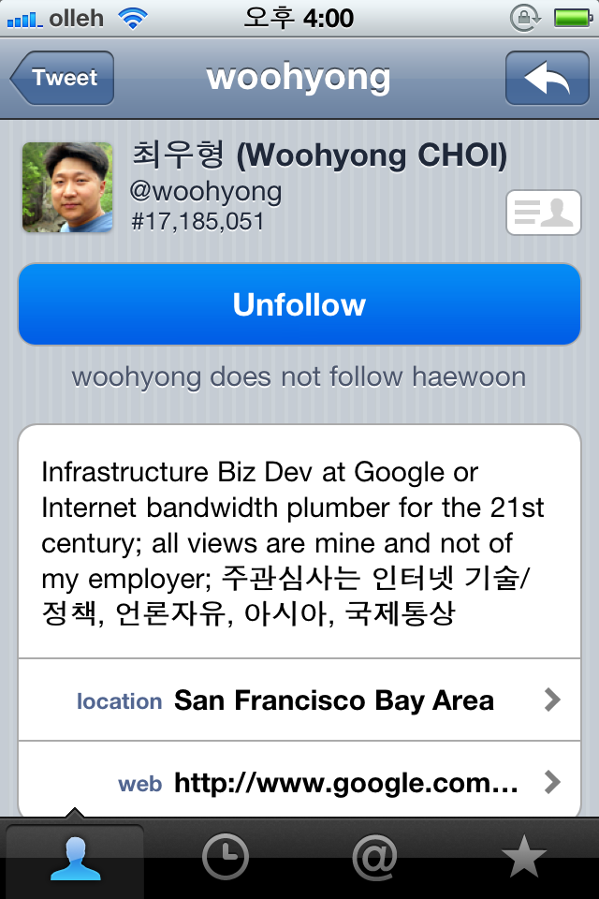
How to know the reciprocity of follows

Slide 30
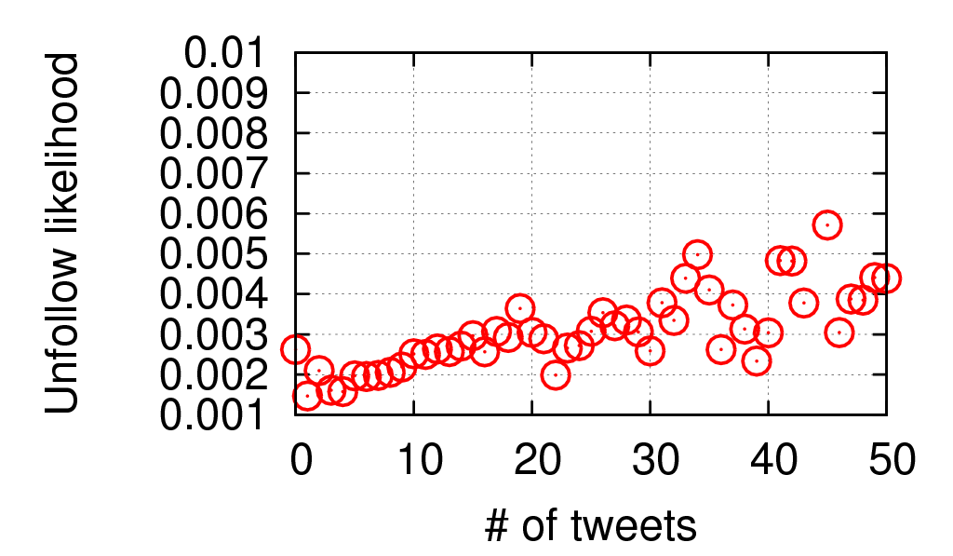
Interviews confirmed by data
Burst tweets are likely to lead unfollow
Followee < 200
Pearson corr. = 0.5833
Notes:
We confirmed the interview results by data.
Interestingly, for all users, we can’t observe any significant correlation trends.
But, focusing on those who have lower than 200 followees, we have a high corerlation between the number of written tweets and unfollow ratio.
This implies that users have many followees … they do not care the burst tweets. Probably, it is because they do not read tweets in their timeline, but they use list feature or Read only mentions.
In this work, we quantitatively and qualitative analyze the dynamics of relationships through relationship dissolution.
Although relationship dissolution has been largely ignored, but we found it frequently occurs and it is not predicted by a proxy such as the volume of activity.
Now we collaborated with sociologists for finding some theory developed in sociology that can explain our findings.

Slide 31
